Slide 1
Empowering Women and Girls through Education
A Pathway to Gender Equality

Slide 2
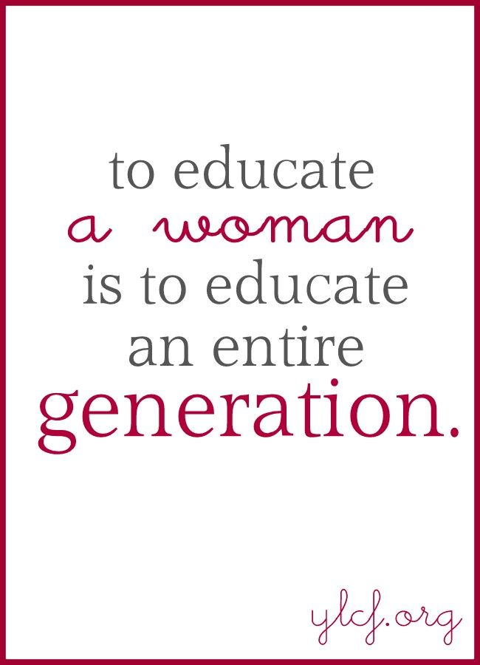
Introduction
Education is a very effective instrument for empowering women and girls. It promotes individual growth, communal improvement, and overall social and economic development. This presentation looks at the impact of education on gender equality, the necessity of literacy initiatives, and the importance of boosting STEM education for females.

Slide 3
The Importance of Education in Empowering Women and Girls

Slide 4
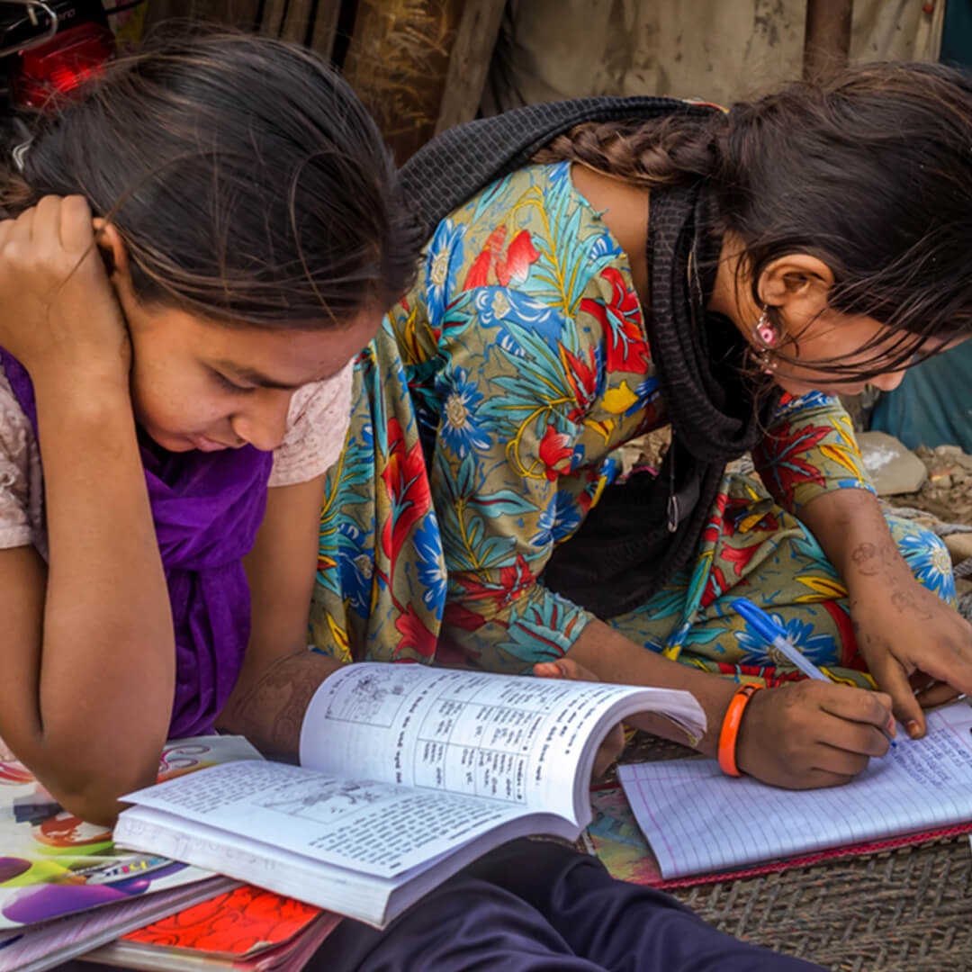
Breaking the Cycle of Poverty:
Education equips women with the knowledge and skills they need to enter the workforce and end the intergenerational cycle of poverty. By entering the workforce, educated women contribute to better their families' financial circumstances, raising them out of poverty. This, in turn, has a long-term impact since educated moms are more inclined to invest in their children's education and well-being, so breaking the cycle of poverty for future generations.

Slide 5
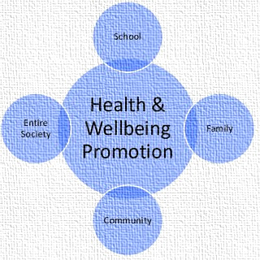
Promoting Health and Well-being
Educated women are more likely to make informed health decisions, resulting in better health outcomes for themselves and their families.

Slide 6
Conti…
Education provides women with the knowledge and tools they need to manage their own and their families' health. Educated women support improved health outcomes, lower death rates, and healthier future generations because they are more cognizant of the significance of preventative behaviors, nutrition, and healthcare. This not only benefits individual families, but it also has a significant impact on public health and society as a whole.

Slide 7
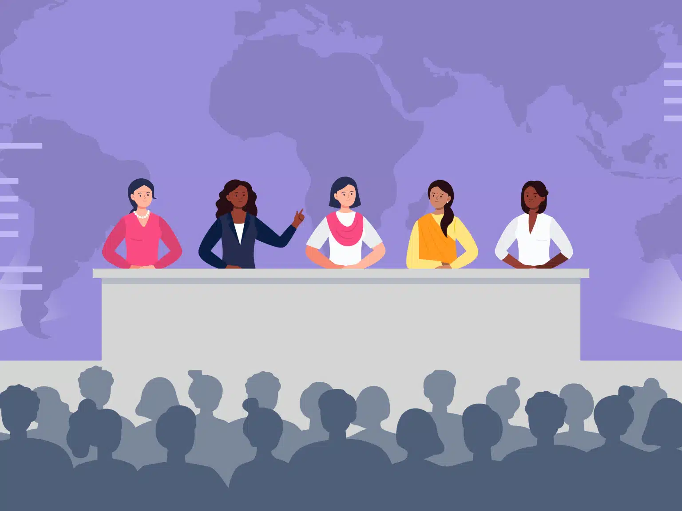
Increasing Political and Social Participation:
Education empowers women to actively participate in decision-making at the family, community, and national levels. Educated women are more involved in household decisions, such as finances, children’s education, and family planning.

Slide 8
Conti…
They frequently take on leadership responsibilities in their communities, fight for social change, and help to resolve conflicts. Nationally, educated women participate in political processes, influence policy, and assume leadership roles that create laws and regulations, particularly those that promote gender equality and public well-being.

Slide 9
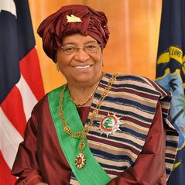
Conti…
Ellen Johnson Sirleaf, Africa's first female head of state, attended Harvard University and used her expertise and leadership abilities to rebuild Liberia following years of civil conflict. During her administration (2006-2018), she worked to improve infrastructure, healthcare, education, and women's rights. Her leadership exemplifies how educated women may hold national leadership positions and impact positive cultural changes.

Slide 10

Reduction in Gender-based Violence:
Education contributes to dispelling gender stereotypes, changing public attitudes, and lowering the incidence of gender-based violence (GBV). It encourages gender equality, gives people the confidence to challenge conventional gender roles, and increases public knowledge of rights and resources.

Slide 11
Conti…
Educated women are more likely to resist and report GBV, but education for men helps them unlearn harmful behaviours. Education encourages lobbying, public conversation, and cultural changes that reduce the acceptance of violence. Educating future generations also helps to minimize intergenerational violence, fostering long-term cultural change towards gender equality and respect.

Slide 12
Ensuring Access to Quality Education

Slide 13
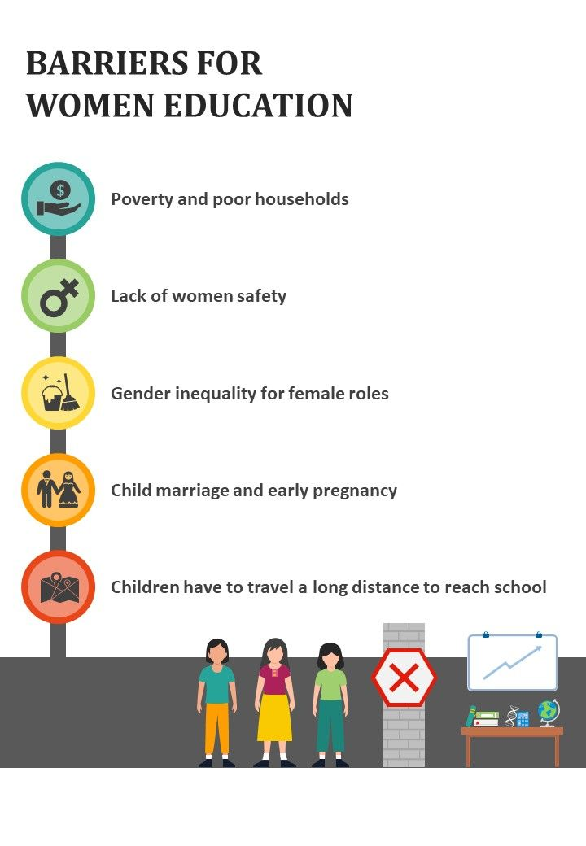
Addressing Barriers to Education:
Cultural Norms
Early Marriages and Pregnancy
Financial Constraints

Slide 14
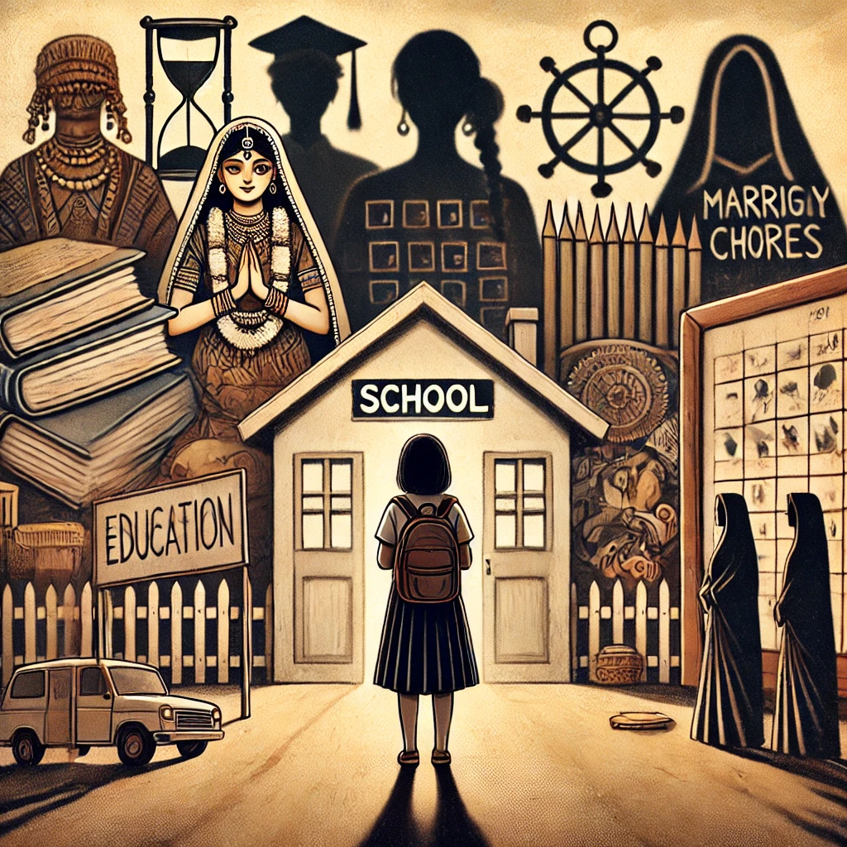
Cultural Norms
Cultural norms frequently impede women's education by reinforcing traditional gender roles, emphasizing household responsibilities, and encouraging early marriage and motherhood. Religious and social attitudes may hinder females' access to a more comprehensive education, while safety concerns and limited mobility further limit options. Economic factors, such as prioritizing males' education or fearing greater dowry payments for educated girls, also have an impact.

Slide 15
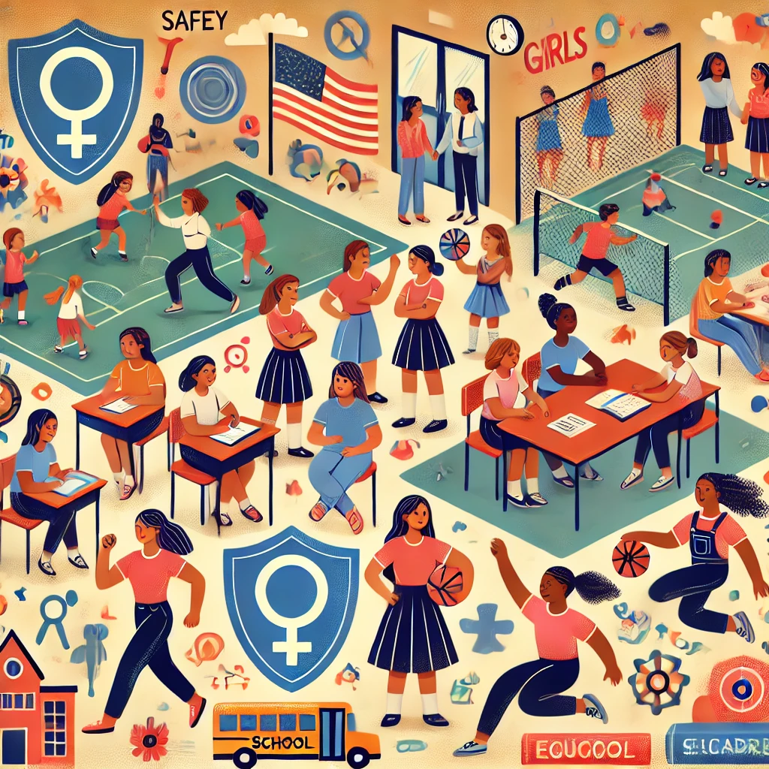
Creating Safe and Inclusive Learning Environments:
Schools should be safe, inclusive environments that safeguard females from violence and discrimination. Strong harassment regulations, equitable opportunity, gender-sensitive education, and support networks for dealing with abuse are all critical components.

Slide 16
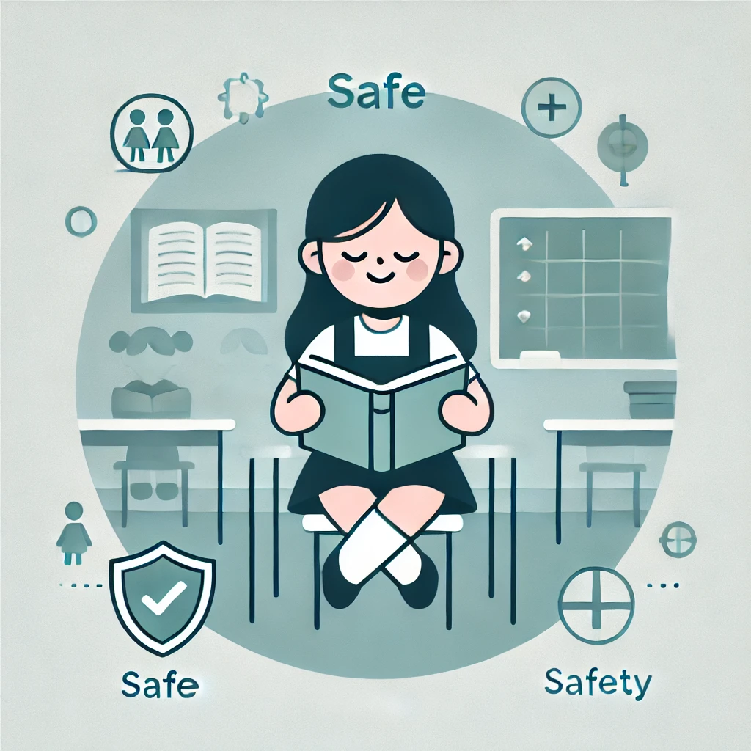
Conti…
Schools can promote gender equality by encouraging females to take on leadership roles and study all courses, while also addressing impediments such as child marriage and providing appropriate facilities. These measures ensure that girls may learn in a safe atmosphere, allowing them to prosper and contributing to a more equal society.

Slide 17
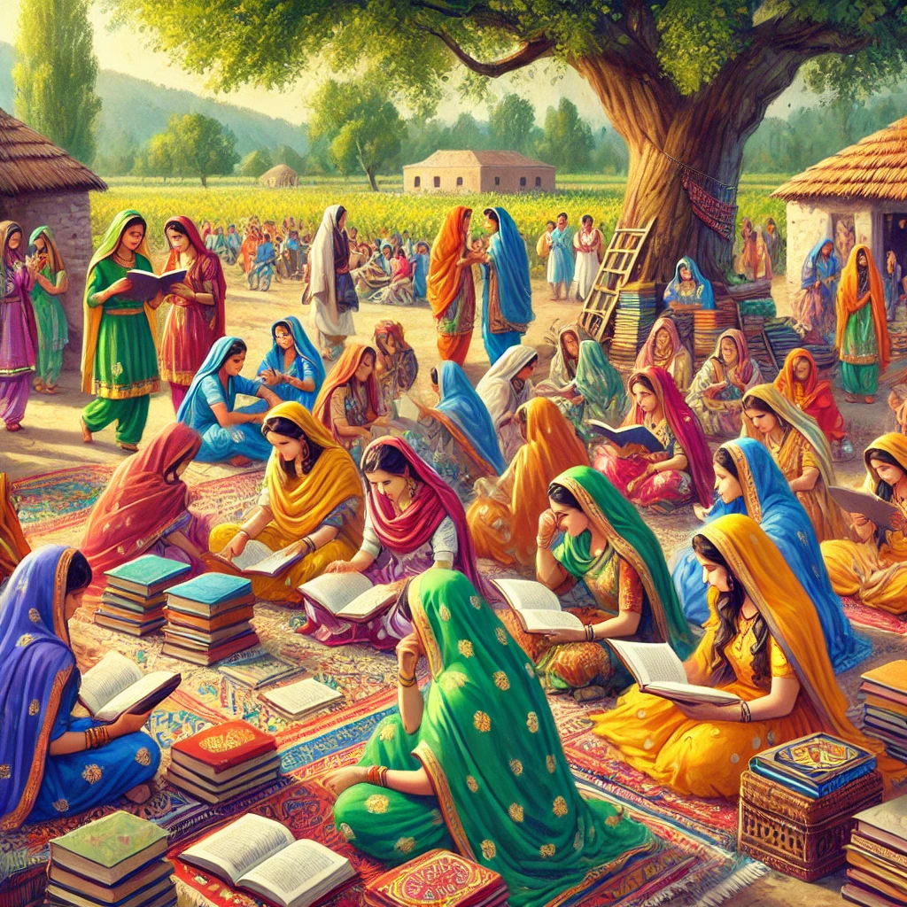
Role of Government
Education Policies:
Governments are responsible for creating policies that ensure equal access to education for all, including girls and women.
Gender-Sensitive Curriculums:
Governments can mandate gender-sensitive education that challenges stereotypes and promotes equality.

Slide 18
Conti…
Conditional Cash Transfers:
In some countries, governments offer cash incentives to families for sending their daughters to school, which helps counter cultural norms that favor boys’ education.
Safe and Inclusive Schools:
Governments are responsible for building and maintaining schools that are safe and accessible for girls. This includes providing separate restrooms for girls, ensuring safe transportation, and creating a harassment-free environment.

Slide 19
Conti…
Laws Against Discrimination:
Governments enact laws that protect girls’ rights to education and prevent gender-based violence in schools. This includes laws against sexual harassment, child marriage, and other practices that hinder girls’ education.
Monitoring and Enforcement:
Governments must also ensure that policies and laws are implemented effectively. This includes monitoring attendance, investigating cases of abuse or discrimination, and taking action against violators.

Slide 20
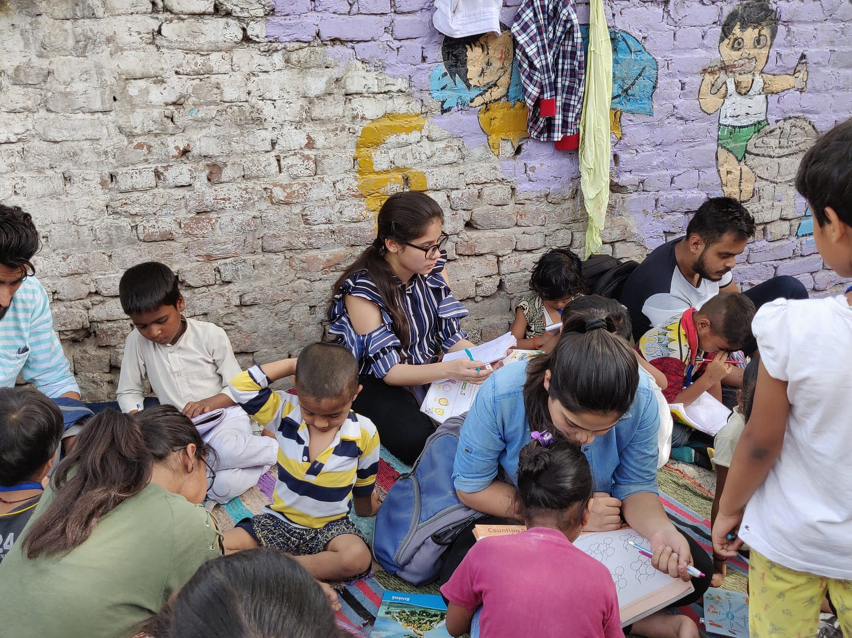
Role of NGOs
Campaigns for Girls' Education:
Many NGOs run national or global campaigns advocating for girls' rights to education, focusing on areas where cultural and economic barriers are strong.
Community Outreach:
NGOs often work directly with communities to raise awareness about the importance of girls' education. They advocate for gender equality and help shift cultural norms that prioritize boys’ education over girls'.

Slide 21
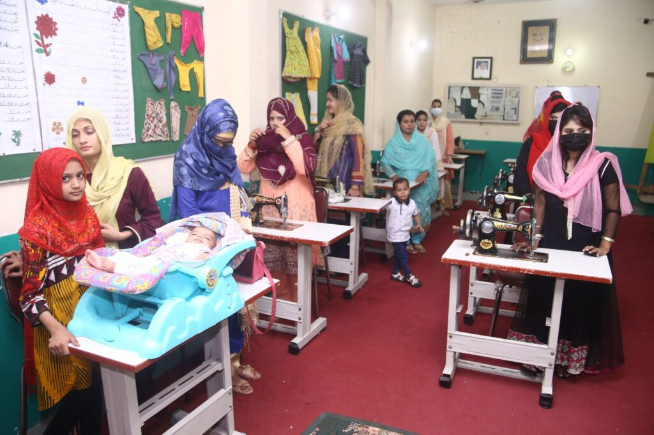
Conti…
Schools and Learning Centers:
In areas where government resources are limited, NGOs build and run schools, especially in rural or marginalized communities.
Training Programs:
NGOs frequently offer vocational training programs for women and girls, enabling them to gain skills that increase their employability and economic independence.

Slide 22
Conti…
Support for Families:
NGOs may also provide financial support to families, such as stipends or livelihood programs, to reduce the economic pressure that often prevents girls from attending school.
Scholarships and Grants:
NGOs offer scholarships and grants to girls who face financial barriers to education. These programs help cover tuition fees, books, and other expenses, making education more accessible.

Slide 23
Conti…
Counseling and Support Services:
NGOs often provide psychosocial support and counseling to girls who have faced violence or discrimination, helping them stay in school and succeed academically.
Partnering with Governments:
NGOs often collaborate with governments to influence education policies and ensure that they are inclusive of girls’ needs. They also help monitor the implementation of these policies.

Slide 24
The Impact of Literacy Programs for Women and Girls

Slide 25
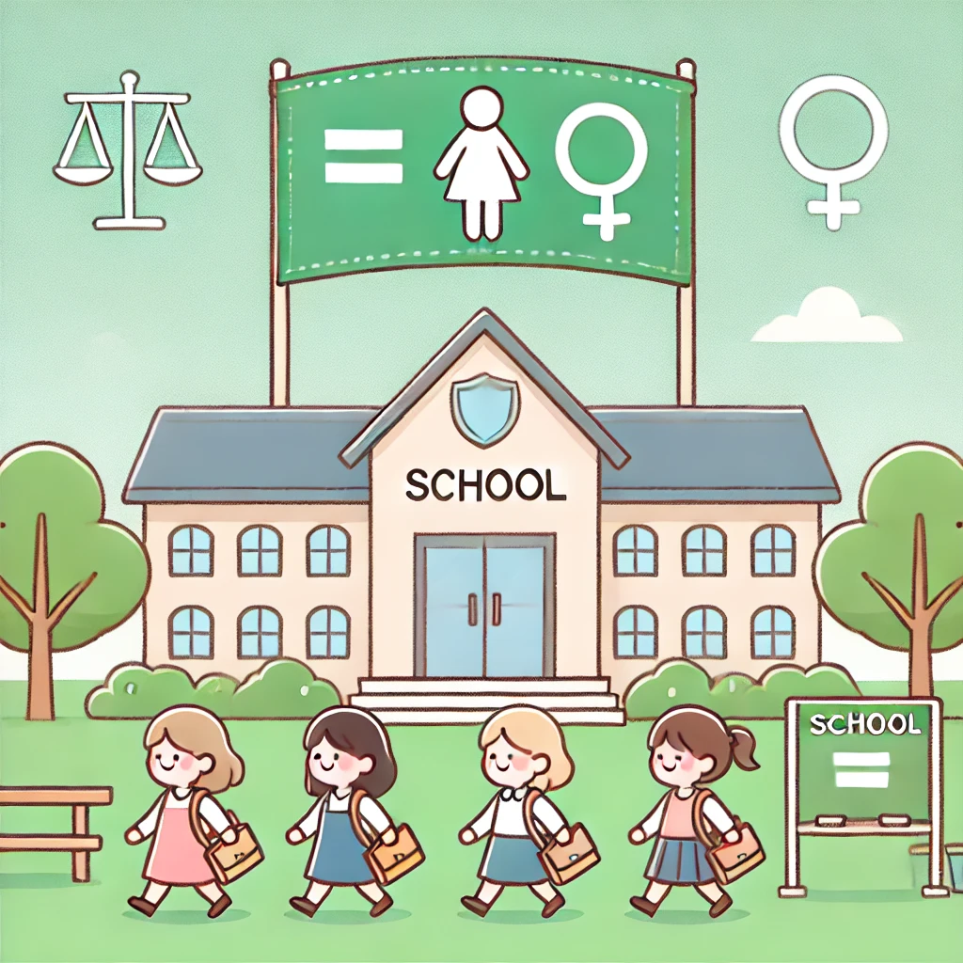
Improving Literacy Rates:
Literacy programs help bridge the gender gap in education, especially in rural and underserved communities.

Slide 26

Creating Economic Opportunities:
Literate women have better chances of gaining employment and engaging in entrepreneurship.

Slide 27
Encouraging Lifelong Learning:
Women who are literate are more likely to keep learning, support their children's education, and participate in community activities.

Slide 28
Promoting STEM Education for Girls

Slide 29
Why STEM Education Matters:
Access to High-Demand Careers:
STEM fields are among the fastest-growing and highest-paying sectors. Encouraging women to enter these fields ensures they have access to stable, lucrative careers in areas like technology, engineering, and healthcare.
Bridging the Gender Gap:
Women remain underrepresented in STEM fields, and encouraging their participation helps bridge the gender gap.

Slide 30
Conti…
Empowering Women Economically:
STEM careers often provide financial independence and opportunities for leadership roles. By pursuing STEM education, women can break traditional economic barriers and achieve greater financial security.
Boosting Innovation:
Diverse perspectives lead to more creative and innovative solutions. Women bring unique viewpoints that are essential in solving complex global problems in science, technology, and engineering.

Slide 31
Conti…
Promoting Problem-Solving and Critical Thinking:
STEM education fosters analytical thinking, creativity, and problem-solving skills. These skills are critical not only in professional careers but also in everyday life, helping women navigate challenges with confidence and insight.
Inspiring Future Generations:
When girls see women thriving in STEM roles, they are more likely to pursue these fields themselves. Women role models in STEM can inspire younger generations, breaking down stereotypes and creating a positive cycle of representation and encouragement.

Slide 32
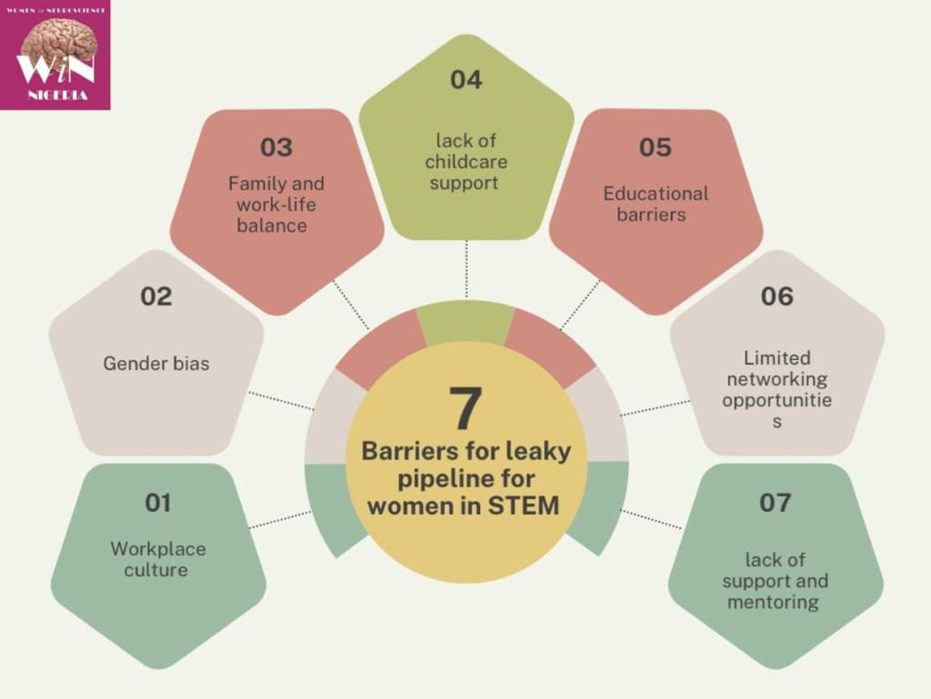
Challenges Faced by Girls in STEM:
Stereotypes and Bias
Lack of Role Models
Insufficient Resources
Gender Pay Gap
Lack of Mentorship Opportunities
Isolation in Workplace

Slide 33
Successful Initiatives to Promote Girls in STEM:

Slide 34
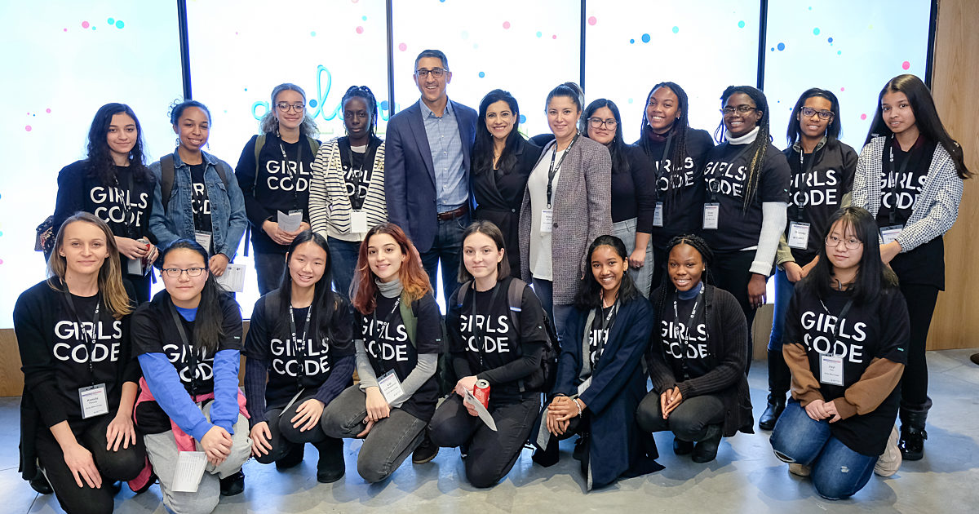
Girls Who Code (USA)
This nonprofit organization offers coding clubs, summer immersion programs, and college-level programs to help girls from diverse backgrounds learn to code. Girls Who Code not only teaches technical skills but also builds a supportive community of female programmers.
The organization has reached over 500,000 girls across the U.S., and alumnae are majoring in computer science at 15 times the national average.

Slide 35
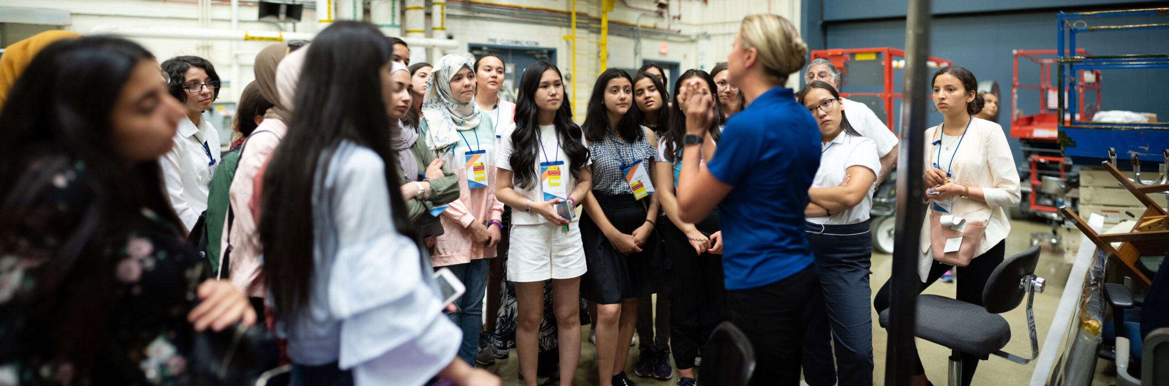
TechGirls (Global)
A U.S. State Department initiative that provides a three-week summer exchange program in the U.S. for high school girls. The program focuses on technology, leadership, and cultural exchange, with the aim of fostering interest in STEM and building global connections.
TechGirls has influenced over 300 alumnae from 35 countries, many of whom have gone on to further studies or careers in STEM fields.

Slide 36
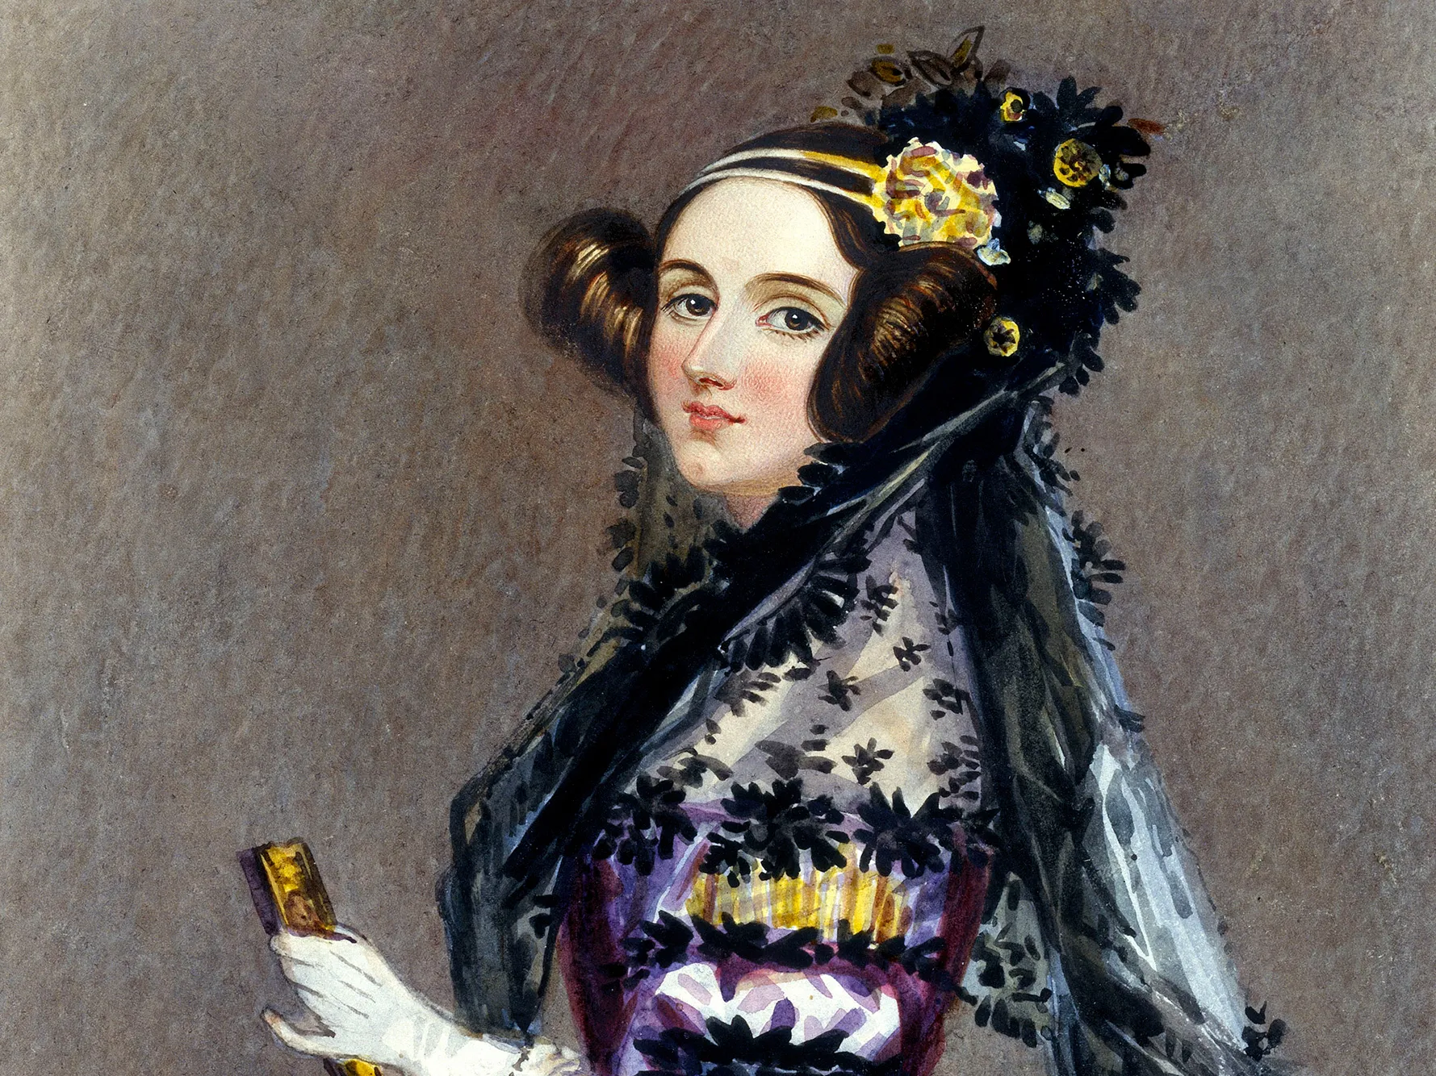
The Ada Lovelace Initiative (Ireland)
This initiative involves school visits by female role models from the tech industry, who share their experiences and provide insights into what a STEM career looks like. They offer talks, workshops, and events that target schools with low female participation in STEM subjects.
The Ada Lovelace Initiative has successfully visited hundreds of schools across Ireland, inspiring many girls to pursue tech education.

Slide 37
Strategies to Enhance Educational Opportunities for Women and Girls

Slide 38
Promote Gender-Inclusive Curriculum
Integrate gender perspectives into all subjects, particularly in STEM fields, to challenge stereotypes and encourage girls' participation.
Highlight the achievements of women in various fields within the curriculum to inspire girls and demonstrate that success is attainable.

Slide 39
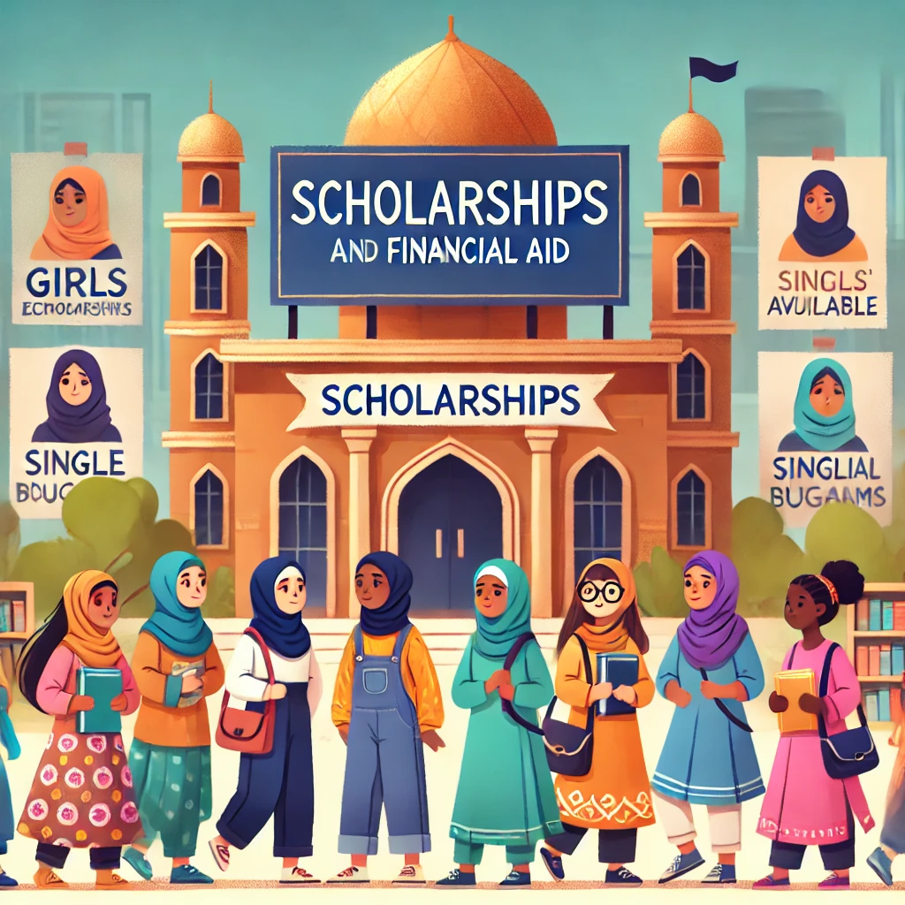
Scholarships and Financial Aid
Provide scholarships exclusively for girls to decrease the financial hurdles to study. This is especially significant in areas where school prices are high.
Create money to help single mothers and economically disadvantaged households support their daughters' education.

Slide 40
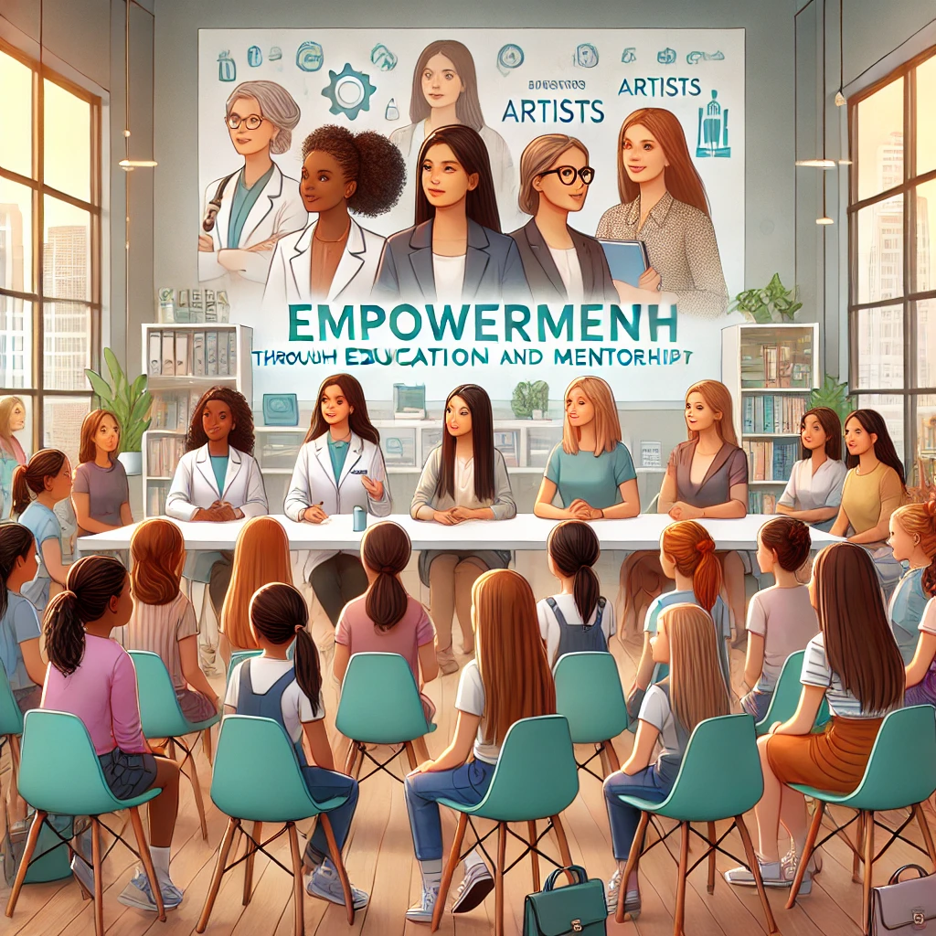
Mentorship and Role Models
Create mentoring programs that connect girls to female leaders in their professions of interest. This can provide instruction, motivation, and networking possibilities.
Organize gatherings where female role models can share their success stories and emphasize the value of education in their lives.

Slide 41
Community Awareness Campaigns
Run awareness programs to educate communities about the importance of girls' education and the beneficial influence it has on society.
Engage community leaders in advocating for girls' education and challenging cultural norms that favor boys' education.

Slide 42
Flexible Learning Options
Provide alternate education choices, such as evening sessions, online courses or mobile schools, to help girls who have family responsibilities or have transportation challenges.
Implement blended learning methods that integrate online and in-person education to increase accessibility.

Slide 43
Policy Advocacy
Advocate for government policies that promote girls' education, such as laws requiring equal access to education, funding for girls' programs, and efforts to lower school dropout rates.
Encourage collaboration among NGOs, educational institutions, and governments to develop coordinated plans and policies that prioritize girls' education.

Slide 44
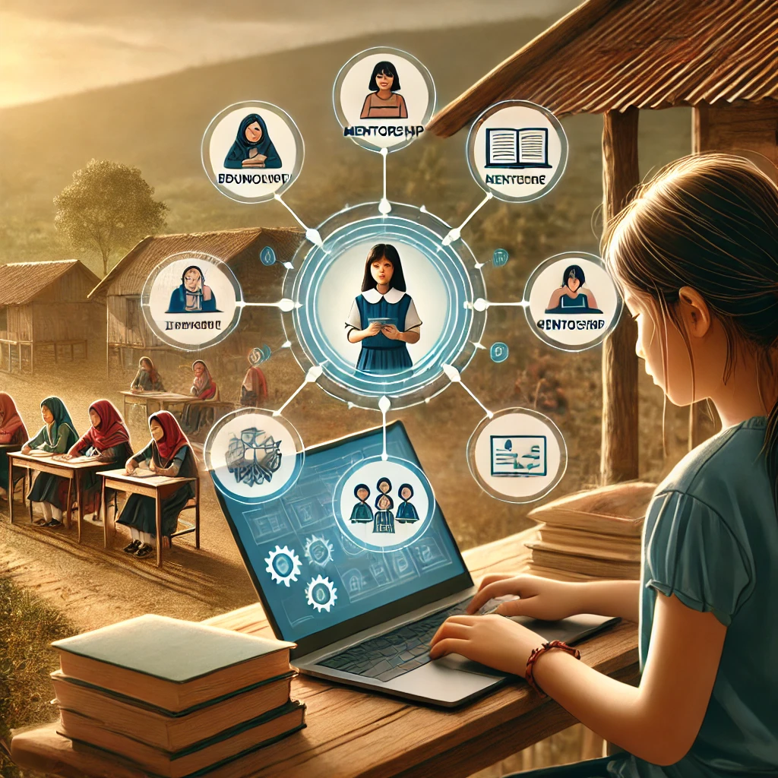
Utilizing Technology
Use technology to offer remote learning opportunities, particularly in locations with limited access to quality education.
Create online platforms that connect girls to educational opportunities, mentors, and support groups.

Slide 45
Monitoring and Evaluation
Set up systems to measure girls' educational progress and evaluate educational programs on a regular basis. Use this information to adjust strategy and improve results.
Collect input from girls on their school experiences to better understand their needs and problems.

Slide 46
Case Studies of Empowerment through Education

Slide 47
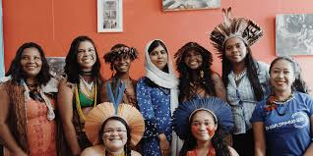
Malala Fund Initiative:
Malala Yousafzai, Pakistan's education advocate and youngest Nobel Prize recipient, launched the Malala Fund in 2013. Its principal aim is to promote girls' education worldwide, particularly in areas plagued by violence, social injustice, and poverty. The organization seeks to ensuring that all girls have access to 12 years of free, safe, and high-quality education.

Slide 48

Rwanda's Gender Parity Strategy:
Rwanda's Gender Parity Strategy is a comprehensive framework designed to promote gender equality and empower women in all sectors of society. Rwanda has been a global leader in gender equality, particularly since the 1994 genocide, when women played an important role in reconstructing the country. The country's commitment to gender equality is evident in its policies, legislation, and political representation, making it a role model for other countries seeking gender balance.

Slide 49
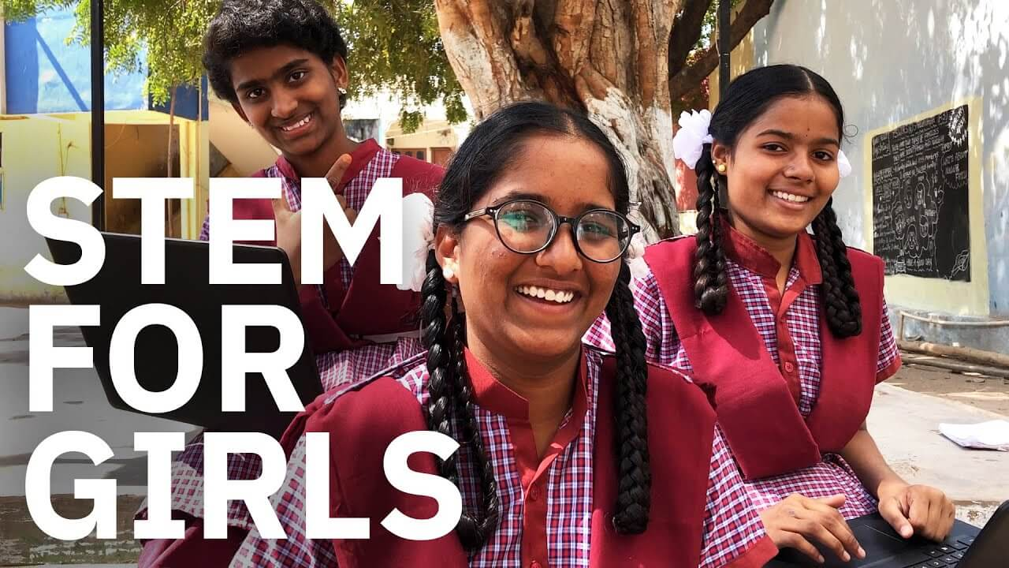
Tech for Girls Initiative in India:
The Tech for Girls Initiative in India seeks to empower young girls by improving their digital literacy and giving training in a variety of tech skills, including coding and web development. It concentrates on increasing access to technology in marginalized communities and provides mentorship from female tech professionals. The initiative also promotes entrepreneurship by providing females with the necessary skills to start their own technology-based businesses.

Slide 50
Conclusion
Empowering girls and women through education is more than just an issue of fairness; it is critical for the long-term growth of societies worldwide. Education creates possibilities, boosts self-confidence, and provides women with the skills they need to make important contributions to their communities and economies. By investing in girls' education, we pave the way for a brighter future in which gender equality is more than simply a goal. Our joint job is to advocate for legislation, promote inclusive environments, and provide the resources required to guarantee that every girl has the opportunity to study, grow, and lead.

Slide 51
References and Further Reading
UNESCO Report on Gender Equality in Education (2020).
UNICEF: Education and Gender Equality.
World Bank: Women and Education.
Girls Who Code: Transforming STEM for Girls.

